Slide 1
Longest common substring(LCS)
Zeyad Ahmed 213949

Slide 2
problem
The Longest Common Substring (LCS) problem involves finding the longest contiguous substring that is common to two given strings. In other words, given two strings, the task is to find the length of the longest sequence of characters that appears in the same order in both strings. The goal is not just to find common characters, but to identify the longest continuous sequence of characters that occurs in both strings.

Slide 3
Startegy
Dynamic programming
Dynamic programming is a problem-solving approach that breaks down a complex problem into simpler overlapping subproblems and solves each subproblem only once, storing the solutions to avoid redundant computations, leading to more efficient solutions.

Slide 4
Algorithm
The Longest Common Substring (LCS) algorithm works by comparing characters of two strings and keeping track of the length of the common substring found so far. It uses a table to store these lengths, updating it as it iterates through the characters. The final result is the longest common substring.

Slide 5

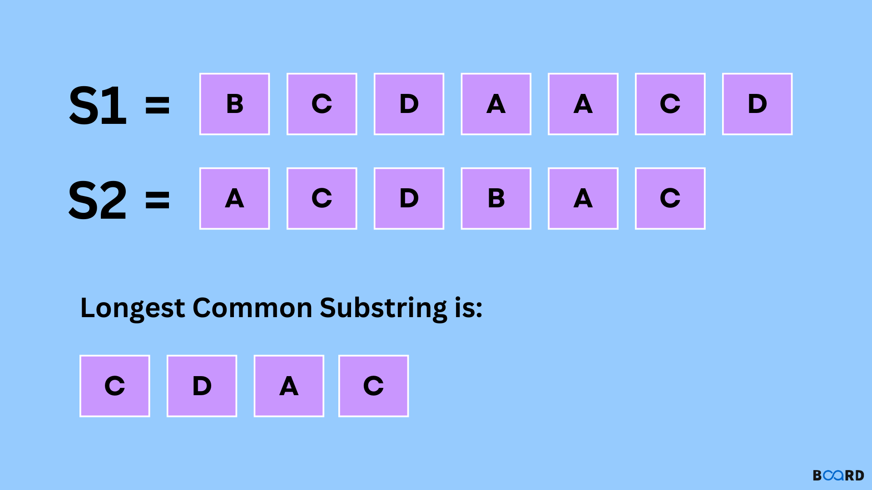

Slide 6
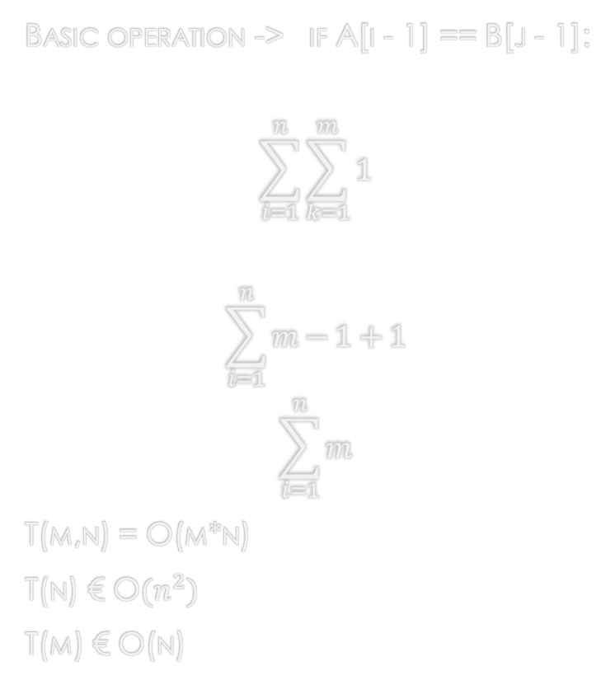
The Analysis
Basic operation -> if A[i - 1] == B[j - 1]:
$$\sum_{i=1}^{n}{\sum_{k=1}^{m}{1}}$$
$$\sum_{i=1}^{n}{m−1+1}$$
$$\sum_{i=1}^{n}{m}$$
T(m,n) = O(m*n)
T(n) € O$(n^{2})$
T(m) € O(n)

Slide 7

Thank You

